Slide 1
SQLdm 6.0
Query Execution Statistics
August 27, 2008
www.idera.com

Slide 2
Problem
Where are queries spending their time?
  How much time are they spending waiting vs. using CPU?
  What are they waiting on?
www.idera.com

Slide 3
Solution
Include a new view/columns in Queries tab allowing users to view CPU vs. wait time
  We would like to show the following wait types:
    System I/O
    Network I/O
    TempDB
    Log
    Lock
    Latch
    CLR
www.idera.com

Slide 4
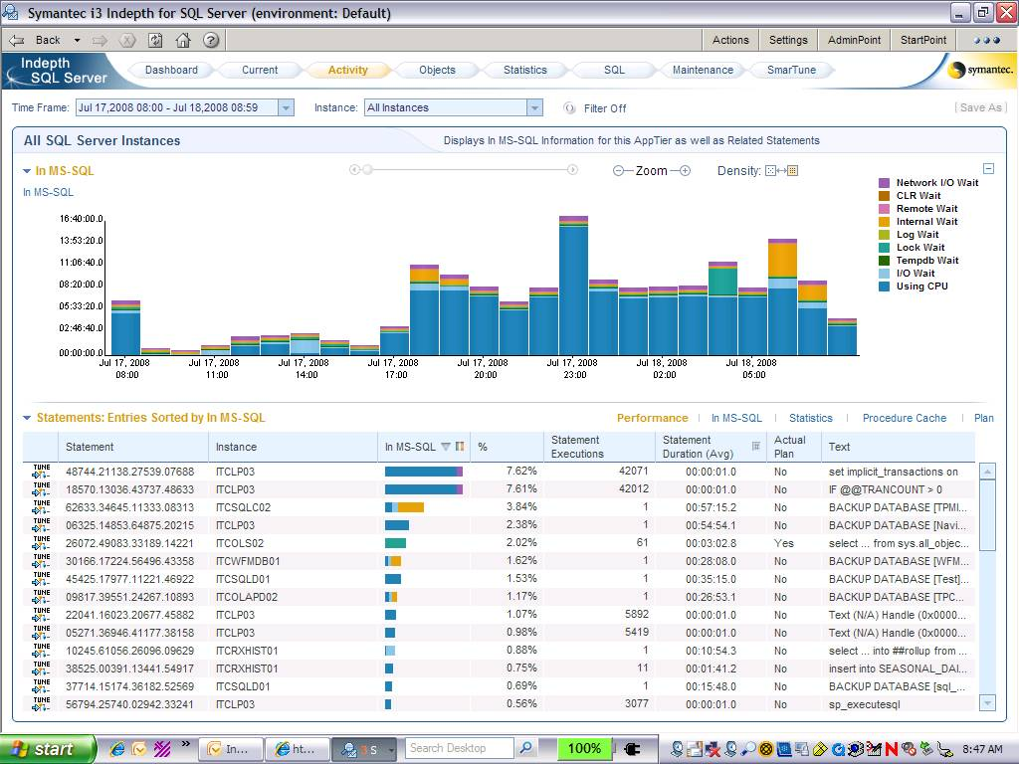
Examples
www.idera.com

Slide 5
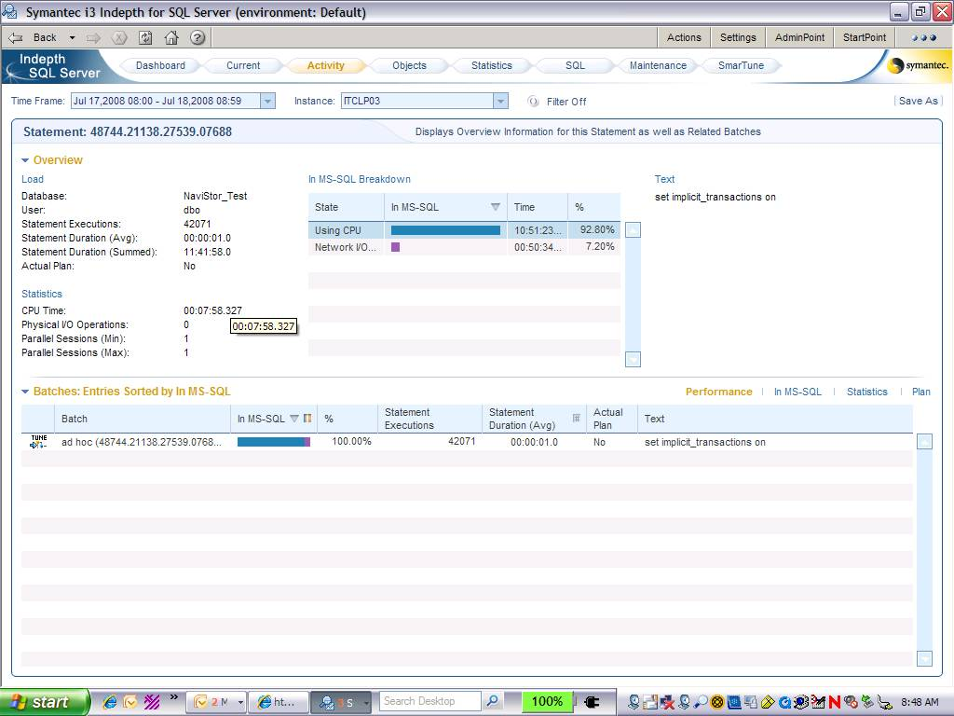
Examples
www.idera.com

Slide 6
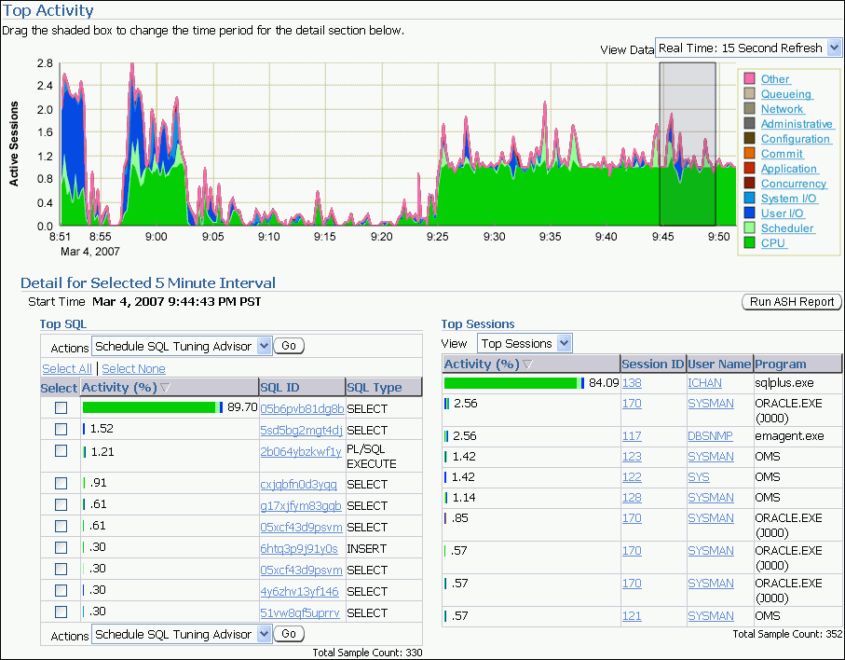
Examples
www.idera.com

Slide 7
How do we get this data?
Collect query wait statistics
  From DMVs?
    This would be difficult, if not impossible, to link to queries captured by Query Monitor Trace
  From XEVENTS?
    This could be added to our Query Monitor Trace
    Only available in SQL Server 2008
  Are there any other alternatives?
www.idera.com

Slide 8
Next Steps
Joe
  Evaluate collection options
    DMVs – Ken Henderson’s Practical Troubleshooting book, first chapter
    XEVENTS - Mario Broodbakker’s Simple Talk article is a good place to start
Trent
  Create view mockup
  Review PRD
www.idera.com

